Slide 1
Registration Procedures
陳毅
Credit：陳煜盛

Slide 2
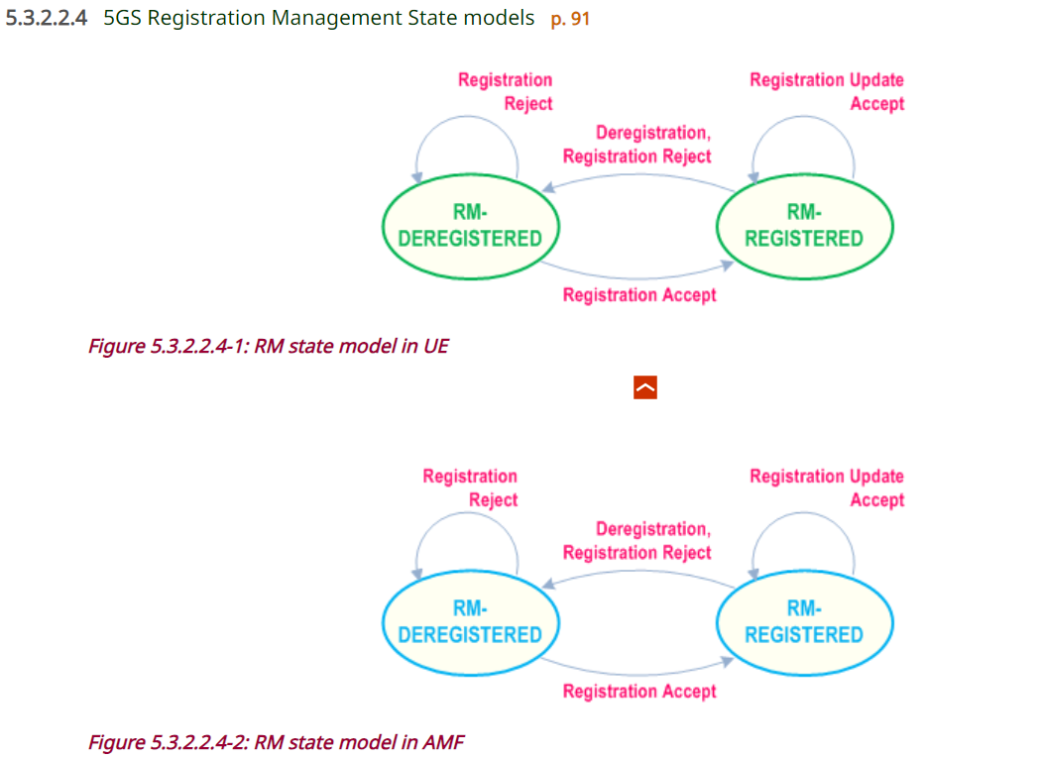
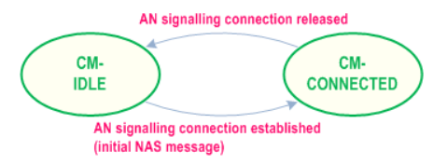
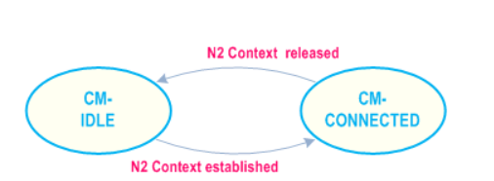
States
AN signaling connection
3GPP RRC_CONNECTED
UE-N3IWF connectivity
UE-TNGF connectivity
UE
AMF
Registration Management States
Connection Management States

Slide 3
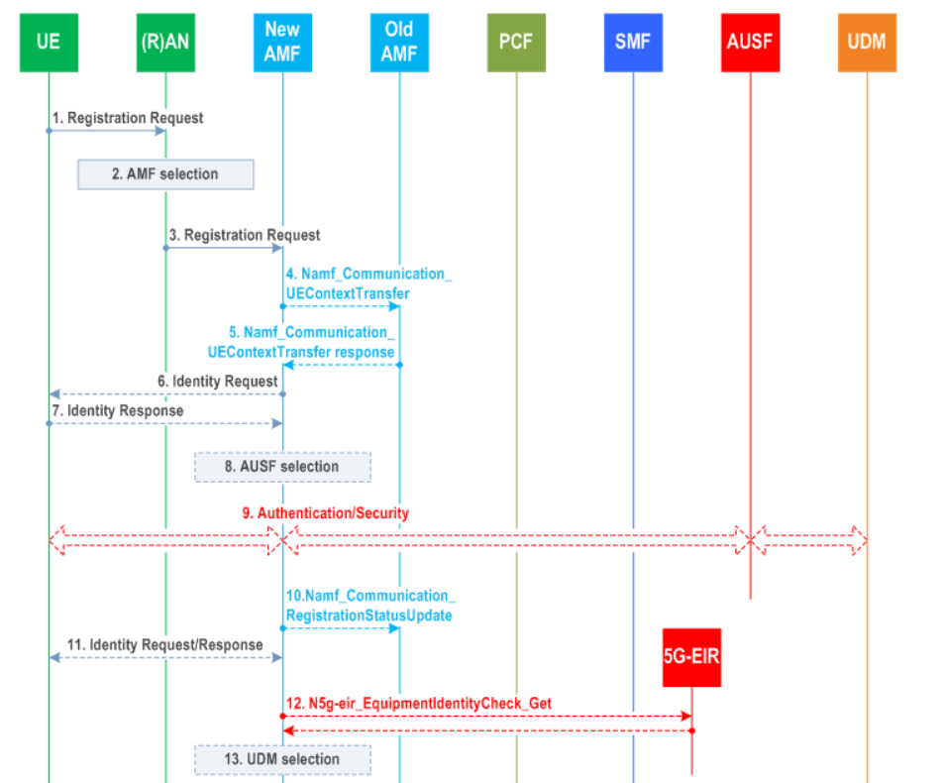
General Registration

Slide 4
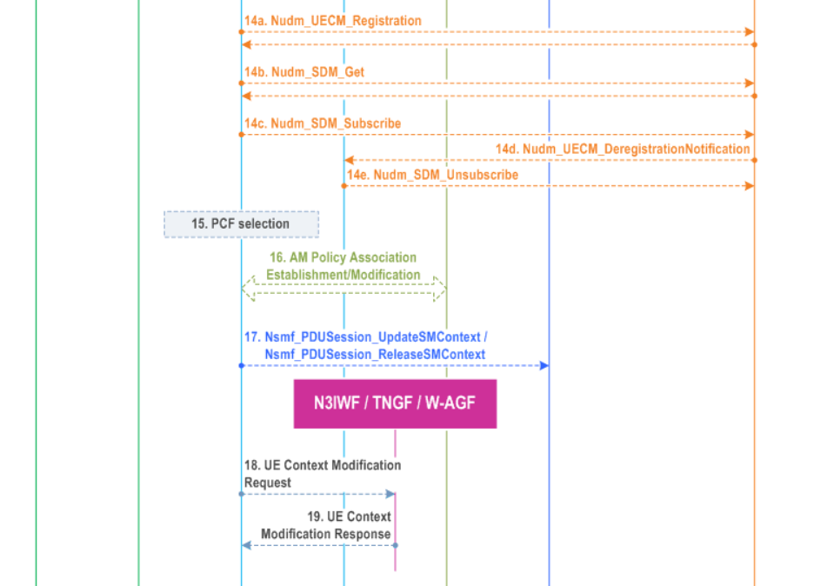
General Registration

Slide 5
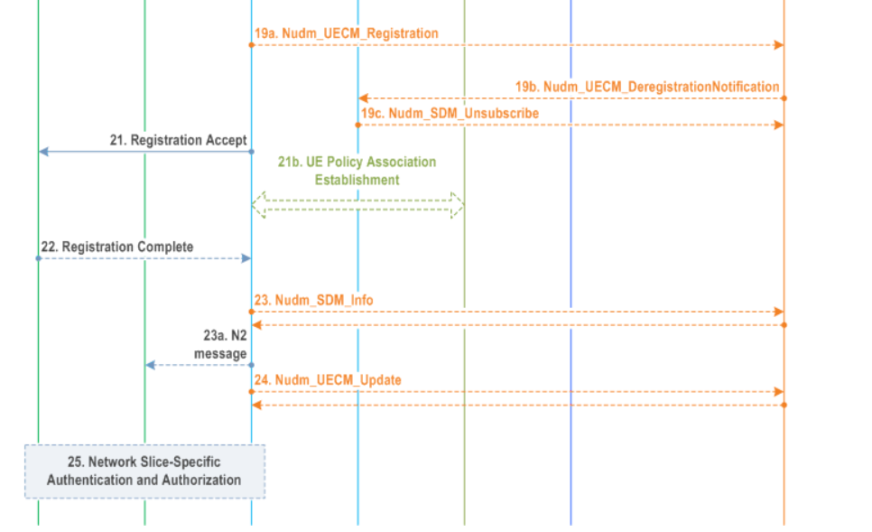
General Registration

Slide 6
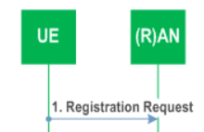
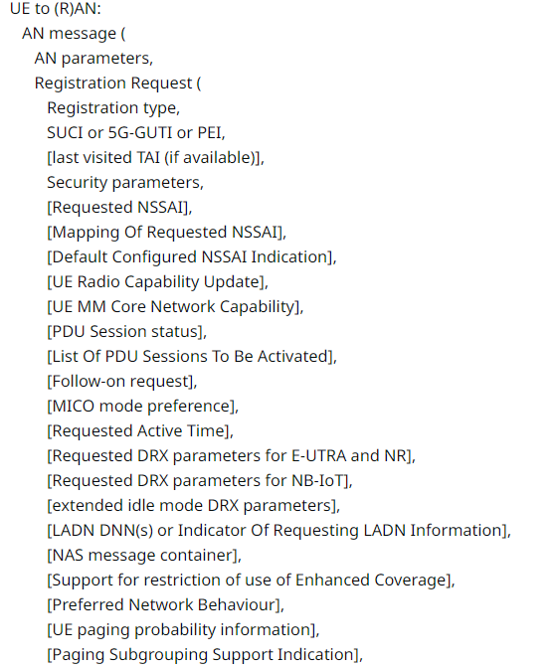
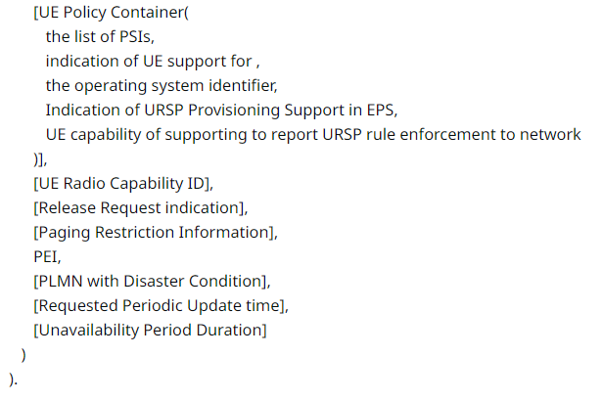
Step 1 – Registration Request

Slide 7
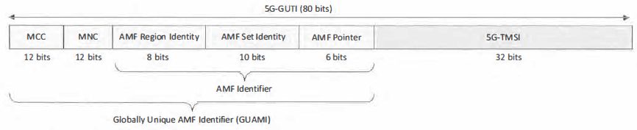
Step 1 – Registration Request
AN parameters:
5G-S-TMSI = <AMF Set ID><AMF Pointer><5G-TMSI>
GUAMI = <AMF Region ID> <AMF Set ID><AMF Pointer>
Selected PLMN ID (or PLMN ID and NID)
Establishment cause
NSSAI information
5G-S-TMSI

Slide 8
Step 1 - Registration Request
Registration Type:
Initial Registration
Mobility Registration Update
due to mobility
UE needs to update its capabilities or protocol parameters
to request a change of the set of network slices it is allowed to use
Periodic Registration Update
Emergency Registration
Disaster Roaming Initial Registration
Disaster Roaming Mobility Registration Update
SNPN Onboarding Registration

Slide 9
Step 1 - Registration Request
UE identity preference:
a 5G-GUTI mapped from an EPS GUTI
a native 5G-GUTI assigned by the PLMN to which the UE is attempting to register
a native 5G-GUTI assigned by an equivalent PLMN to the PLMN to which the UE is attempting to register
a native 5G-GUTI assigned by any other PLMN
otherwise, the UE shall include its SUCI

Slide 10
Step 1 - Registration Request
If using native 5G-GUTI,
GUAMI shall be indicated in the AN parameters
Otherwise,
GUAMI shall not be indicated in the AN parameters
In Emergency Registration,
If no 5G-GUTI => SUCI
If no SUPI, and 5G-GUTI => PEI

Slide 11
Step 1 - Registration Request
The NAS message container shall be included if the UE is sending a Registration Request message as an Initial NAS message and the UE has a valid 5G NAS security context and the UE needs to send non-cleartext IEs.

Slide 12

Step 1 - Registration Request
Requested NSSAI
Mapping Of Requested NSSAI
the mapping of each S-NSSAI of the Requested NSSAI to the HPLMN S-NSSAIs
Default Configured NSSAI

Slide 13
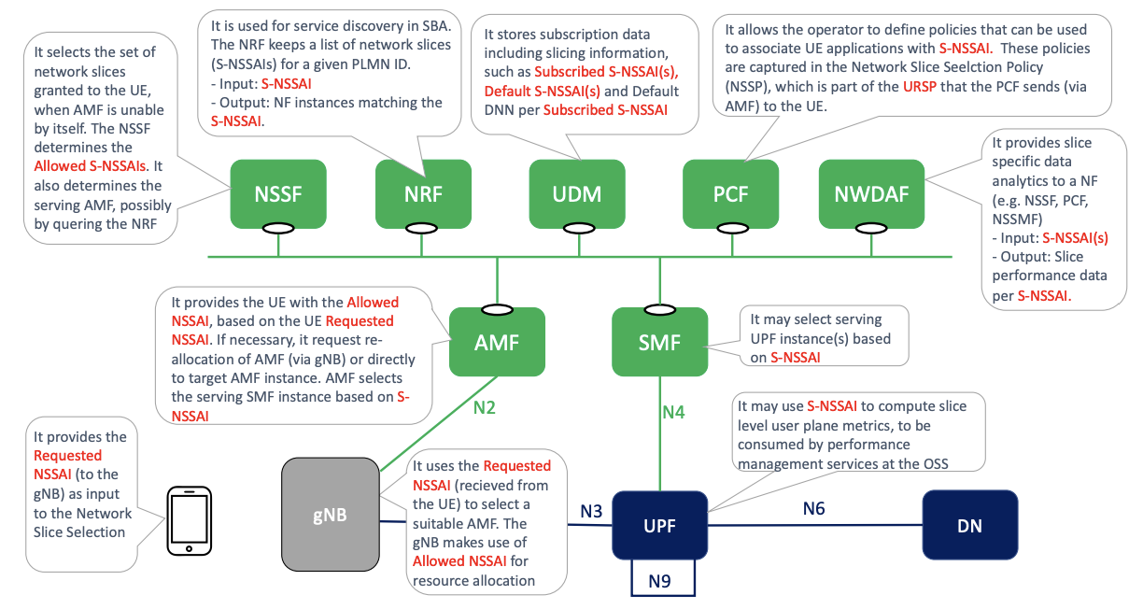
Step 1 - Registration Request
Reference: On the Rollout of Network Slicing in Carrier Networks: A Technology Radar

Slide 14
Step 1 - Registration Request
In Mobility Registration Update case, it includes
PDU Sessions for pending uplink data
always-on PDU Sessions
A PDU Session corresponding to a LADN is not included in the List Of PDU Sessions To Be Activated when the UE is outside the area of availability of the LADN.

Slide 15
Step 1 - Registration Request
UE MM Core Network Capability indicates if UE support:
Request Type flag “handover”
Strictly Periodic Registration Timer Indication
CAG
equivalent SNPNs
Unavailability Period Support
…

Slide 16
Step 1 - Registration Request
Security parameters are used for Authentication and integrity protection.
PDU Session status indicates the previously established PDU Sessions in the UE.

Slide 17
Step 2 – AMF selection
If no 5G-S-TMSI or GUAMI, base on:
(R)AT
Requested NSSAI
If UE is in CM-CONNECTED state,
the (R)AN can forward the Registration Request message to the AMF based on the N2 connection of the UE.

Slide 18
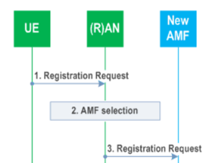
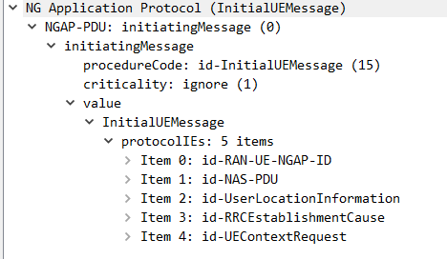
Step 3 - N2 message (N2 parameters, Registration Request)
N2 parameters
Selected PLMN ID (or PLMN ID and NID)
Location Information
Cell Identity
UE Context Request including security information
Establishment Cause
IAB-Indication (if AN parameter indicates it)
Notes:
Integrated access and backhaul (IAB) enables wireless in-band and out-of-band relaying of NR Uu access traffic via NR Uu backhaul links

Slide 19
Step 3 - N2 message (N2 parameters, Registration Request)
If Registration type == Periodic Registration Update
omit steps 4 ~ 19
(AMF) If Service Gap timer still running
ignore: Follow-on Request & Uplink data status

Slide 20
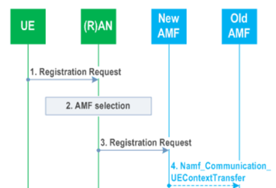
Step 4 (Conditional)
New AMF determines the old AMF using 5G-GUTI
To retrives SUPI and UE context
With UDSF,
Nudsf_UnstructuredDataManagement_Query
Without UDSF,
Namf_Communication_UEContextTransfer including
the complete Registration Request NAS message (may be integrity protected)
Access Type

Slide 21


Step 5 (Conditional)
UDSF response
established PDU Sessions
Old AMF response
SUPI
UE Context
SMF information
DNN
S-NSSAI(s)
PDU Session ID(s)
active NGAP UE-TNLA bindings to N3IWF/TNGF/W-AGF

Slide 22
Step 5 (Conditional)
If old AMF fails the integrity check of the Registration Request NAS message, the old AMF shall indicate the integrity check failure.
If the new AMF is configured to allow emergency services for unauthenticated UE:
If the UE has only an emergency PDU Session, the AMF either skips the authentication and security procedure or accepts that the authentication may fail and continues the Mobility Registration Update procedure.
If the UE has both emergency and non emergency PDU Sessions and authentication fails, the AMF continues the Mobility Registration Update procedure and deactivates all the non-emergency PDU Sessions.

Slide 23
Step 5 (Conditional)
…
Old AMF may includes (if available)
AM Policy Association
UE Policy Association
PCF ID
V-PCF ID (roaming case)
H-PCF ID (roaming case)

Slide 24
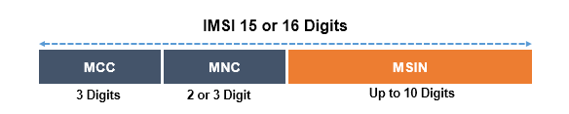
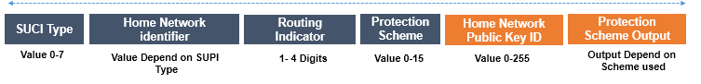
Step 6, 7 (Conditional)
…
When SUCI is not
provided by UE
retrieved from the old AMF
AMF sending an Identity Request message to the UE requesting the SUCI.
The UE responds with an Identity Response message including the SUCI.
The UE derives the SUCI by using the provisioned public key of the HPLMN.
SUPI
SUCI

Slide 25
Step 8
…
The AMF may decide to initiate UE authentication
AMF selects an AUSF based on SUPI or SUCI.
AMF may skip authentication or accepts authentication failure if Registration type == Emergency Registration

Slide 26
Step 9a
…
If authentication is required, AMF may include:
Tracing Requirements (if available)
indication of Disaster Roaming service
AUSF selects a UDM to gets the authentication data
Once the UE has been authenticated
AUSF provides relevant security information to the AMF
SUPI
After successful authentication in new AMF triggered by the integrity check failure in old AMF at step 5
new AMF invokes step 4 again

Slide 27
Step 9b
If NAS security context does not exist, the NAS security initiation is performed.
If the UE had no NAS security context in step 1, the UE includes the full Registration Request message.

Slide 28
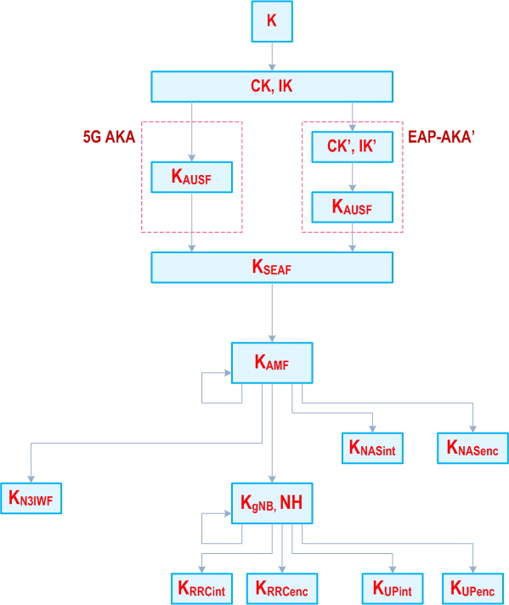
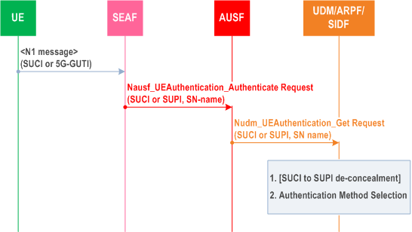
Step 9b
…
2 Authentication procedures in 5GC
EAP-AKA’
5G AKA
Initiation of the primary authentication

Slide 29
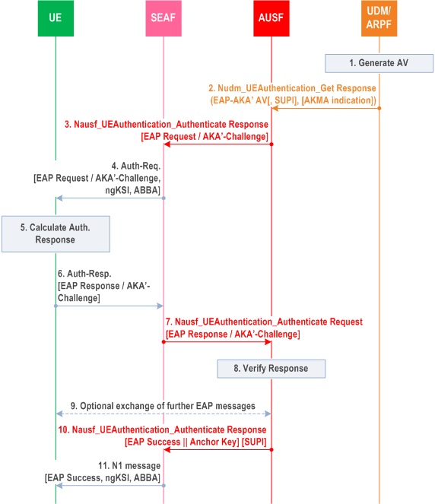
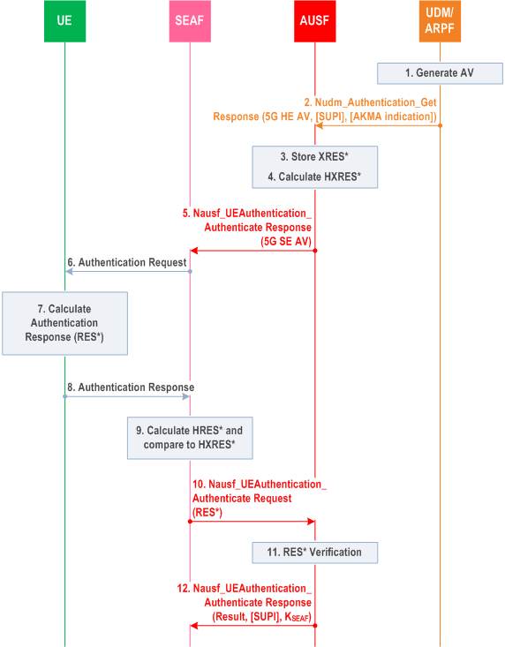
EAP-AKA’ (Extensible Authentication Protocol)
5G-AKA

Slide 30
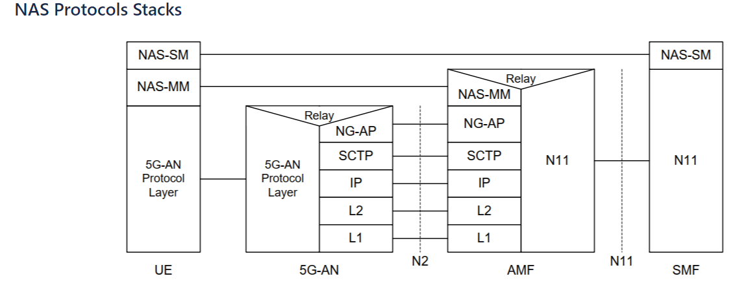
NAS Protocols Stacks

Slide 31
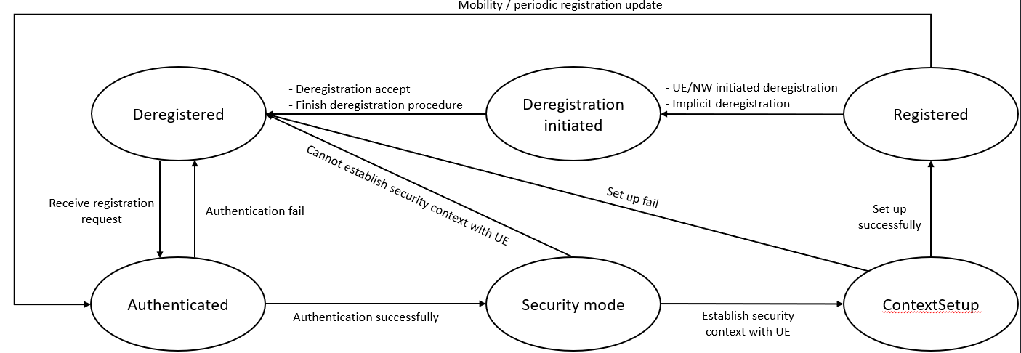
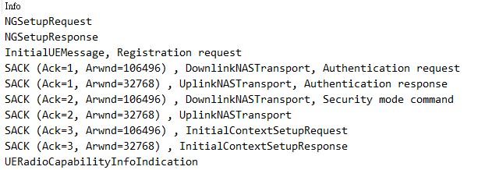
In Wireshark

Slide 32
Step 9c, 9d
The AMF initiates NGAP procedure to provide the 5G-AN with security context if the 5G-AN had requested for UE Context.
The 5G-AN stores the security context and acknowledges to the AMF.

Slide 33
Step 10 (Conditional)
…
Namf_Communication_RegistrationStatusUpdate (PDU Session ID(s) to be released e.g. due to slice not supported)
new AMF informs the old AMF that the registration of the UE in the new AMF is completed
New AMF determines the PDU Session(s) that cannot be supported in the new Registration Area in the cases below:
If one or more of the S-NSSAIs used in the old Registration Area cannot be served in the target Registration Area.
When continuity of the PDU Session(s) cannot be supported between networks (e.g. SNPN-SNPN mobility, inter-PLMN mobility where no HR agreement exists).

Slide 34
Step 10 (Conditional)
…
New AMF includes:
rejected PDU Session ID
old AMF informs the corresponding SMF(s) to locally release the UE's SM context by invoking the Nsmf_PDUSession_ReleaseSMContext
If UE context transfer received in step 5 is no longer used, new AMF shall inform the old AMF that the information listed below is not used any longer:
AM Policy Association
UE Policy Association
PCF ID
And the new AMF will perform step 15.

Slide 35
Step 11 (Conditional)
…
Identity Request/Response (PEI)
[Condition] If the PEI was not provided by the UE nor retrieved from the old AMF
The PEI shall be transferred encrypted unless UE performs Emergency Registration

Slide 36
Step 12 (Optional)
the new AMF initiates ME identity check by invoking the N5g-eir_EquipmentIdentityCheck_Get
For an Emergency Registration, if the PEI is blocked, operator policies determine whether the Emergency Registration procedure continues or is stopped.

Slide 37
Step 13
If step 14 is to be performed, the new AMF, based on the SUPI, selects a UDM, then UDM may select a UDR instance

Slide 38
Step 14a-c
New AMF registers with the UDM using Nudm_UECM_Registration in any one condition:
AMF has changed
UE Registration type is Initial Registration or Emergency Registration
UE provides a SUPI which does not refer to a valid context in the AMF
UE registers to the same AMF it has already registered to a non-3GPP access
If the AMF does not have subscription data for the UE, the AMF retrieve these data using Nudm_SDM_Get
Access and Mobility Subscription data
SMF Selection Subscription data
UE context in SMF data
LCS mobile origination
This requires that UDM may retrieve this information from UDR by Nudr_DM_Query

Slide 39
Step 14a-c
After a successful response is received
the AMF subscribes to be notified using Nudm_SDM_Subscribe
UDM may subscribe to UDR by Nudr_DM_Subscribe

Slide 40
Step 14d
When the UDM stores the associated Access Type (e.g. 3GPP) together with the serving AMF, it will cause the UDM to initiate a Nudm_UECM_DeregistrationNotification corresponding to the same (e.g. 3GPP) access.
Old AMF may remove the UE context for the same Access Type
If the serving NF removal reason indicated by the UDM is Initial Registration, the old AMF invokes the Nsmf_PDUSession_ReleaseSMContext (SM Context ID) towards all the associated SMF(s)

Slide 41
Step 14d
If PCF ID is not transferred or will not be used by New AMF, Old AMF performs
AMF-initiated Policy Association Termination procedure
AMF-initiated UE Policy Association Termination procedure
If the old AMF has an N2 connection for that UE, the old AMF shall perform AN Release

Slide 42
Step 14e (Conditional)
If old AMF does not have UE context for another access type (i.e. non-3GPP access), the Old AMF unsubscribes with the UDM for subscription data using Nudm_SDM_unsubscribe.

Slide 43
Step 15
If the new AMF decides to use the (V-)PCF ID included in UE context from the old AMF in step 5, the AMF contacts the (V-)PCF identified by the (V-)PCF ID to obtain policy.

Slide 44
Step 16 (Optional)
For an Emergency Registration, this step is skipped.
PCF shall provide the updated Mobility Restrictions to the AMF, if
AMF notifies the Mobility Restrictions to the PCF for adjustment, or
PCF updates the Mobility Restrictions itself
If the AMF supports DNN replacement
AMF provides the PCF with the Allowed NSSAI
Mapping Of Allowed NSSAI (if available)
If the PCF supports DNN replacement, the PCF provides the AMF with triggers for DNN replacement.

Slide 45
Step 17 (Conditional)
The AMF invokes the Nsmf_PDUSession_UpdateSMContext in the following scenarios:
If the List Of PDU Sessions To Be Activated is included in the Registration Request, AMF sends Nsmf_PDUSession_UpdateSMContext Request to SMF(s) associated with the PDU Session(s) in order to activate User Plane connections.
If the AMF has determined in step 3 that the UE is performing Inter-RAT mobility to or from NB-IoT, the AMF sends Nsmf_PDUSession_UpdateSMContext Request to SMF(s) associated with the UEs PDU Session(s), so the SMF(s) can update them according to the "PDU Session continuity at inter RAT mobility" subscription data.

Slide 46
Step 17 (Conditional)
When the serving AMF has changed, the new serving AMF notifies the SMF for each PDU Session that it has taken over the responsibility of the signalling path towards the UE by Nsmf_PDUSession_UpdateSMContext.
It also indicates whether the PDU Session is to be re-activated.
If any PDU Session status indicates that it is released at the UE, the AMF invokes the Nsmf_PDUSession_ReleaseSMContext

Slide 47
Step 18-19 (Conditional)
skip

Slide 48
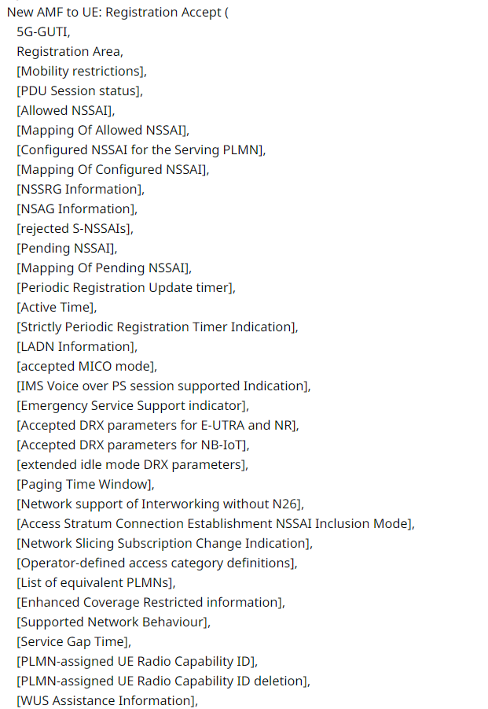
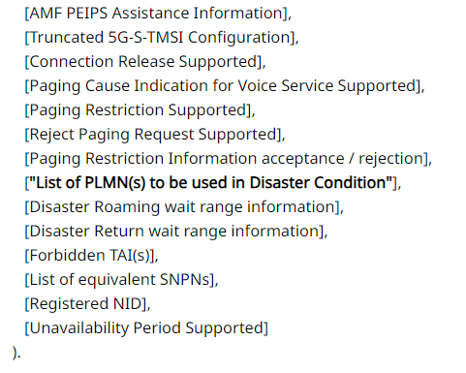
Step 21
Registration Accept

Slide 49
Step 21b (Optional)
The new AMF sends a Npcf_UEPolicyControl Create Request to PCF. PCF sends a Npcf_UEPolicyControl Create Response to the new AMF.
PCF triggers UE Configuration Update Procedure.

Slide 50
Step 22
The UE sends a Registration Complete message to the AMF to acknowledge if a new 5G-GUTI was assigned.
AMF shall release the signalling connection with UE if
the List Of PDU Sessions To Be Activated is not included in the Registration Request and the Registration procedure was not initiated in CM-CONNECTED state.
the UE has provided Unavailability Period Duration in step 1
AMF shall not release the signalling connection with UE if
the Follow-on request is included in the Registration Request; or
the AMF is aware that some signalling is pending in the AMF or between the UE and the 5GC.

Slide 51
Step 22
If PLMN-assigned UE Radio Capability ID is included in step 21, the AMF stores it in UE context if receiving Registration Complete message.
If the UE receives PLMN-assigned UE Radio Capability ID deletion indication in step 21, the UE shall delete the PLMN-assigned UE Radio Capability ID(s) for this PLMN.

Slide 52
Step 23 (Conditional)
If the Access and Mobility Subscription data provided by UDM to AMF in 14b includes Steering of Roaming information with an indication that the UDM requests an acknowledgement of the reception of this information from the UE, the AMF provides the UE acknowledgement to UDM using Nudm_SDM_Info

Slide 53
Step 23a
For Registration over 3GPP Access, if the AMF does not release the signalling connection, the AMF sends the RRC Inactive Assistance Information to the NG-RAN

Slide 54
Step 24
After step 14a and in parallel to any of the preceding steps, the AMF shall send a "Homogeneous Support of IMS Voice over PS Sessions" indication to the UDM using Nudm_UECM_Update

Slide 55
Step 25 (Conditional)
Condition
the UE indicates its support for Network Slice-Specific Authentication and Authorization procedure in the UE MM Core Network Capability in Registration Request; and
any S-NSSAI of the HPLMN is subject to Network Slice-Specific Authentication and Authorization

Slide 56
Step 25 (Conditional)
Once the Network Slice-Specific Authentication and Authorization procedure is completed for all S-NSSAIs, the AMF shall trigger a UE Configuration Update procedure to deliver an Allowed NSSAI containing also the S-NSSAIs for which the Network Slice-Specific Authentication and Authorization was successful, and include any rejected NSSAIs with an appropriate rejection cause value.
The AMF stores an indication in the UE context for any S-NSSAI of the HPLMN subject to Network Slice-Specific Authentication and Authorization for which the Network Slice-Specific Authentication and Authorization succeeds.

